Slide 1

CSC 240 Final Project
Bop or Flop?
Hit Prediction on Spotify
Justin Lee & Sammy Potter

Slide 2
What is a bop?
We define a bop as a song that could be featured on the Top 100 Billboard.
Bop or Flop? | Justin Lee & Sammy Potter

Slide 3
Goals:
Classify songs in the dataset as bops or flops
Predict songs outside the dataset
Bop or Flop? | Justin Lee & Sammy Potter

Slide 4
Approach
1
2
3
4
Results
& Analysis
Data Cleaning
Model Training
Demo
Bop or Flop? | Justin Lee & Sammy Potter

Slide 5



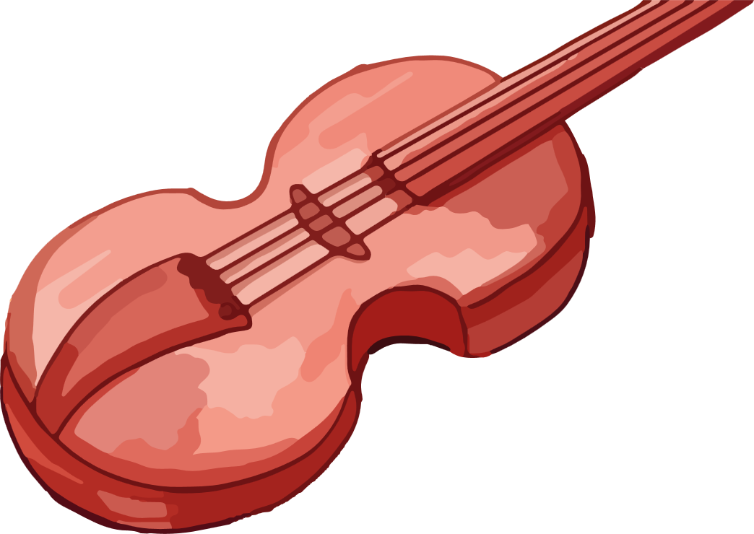



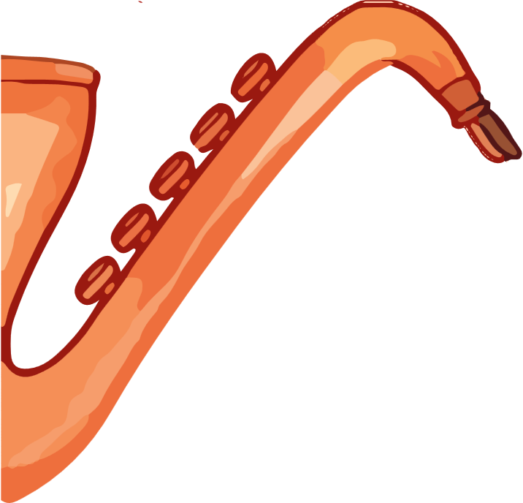

Step 1:
Data Cleaning & Preprocessing
Data Concatenation
Summary Statistics
Data Visualization
Bop or Flop? | Justin Lee & Sammy Potter

Slide 6
The Spotify Hit Predictor Dataset (1960-2019)
Tracks and features taken from Spotify Web API
28,774 tracks with 19 normalized attributes each
No missing data
└── dataset.zip/
├── dataset-of-60s.csv
├── dataset-of-70s.csv
├── dataset-of-80s.csv
├── dataset-of-90s.csv
├── dataset-of-00s.csv
└── dataset-of-10s.csv
Need to concatenate data!
Bop or Flop? | Justin Lee & Sammy Potter

Slide 7
The Spotify Hit Predictor Dataset (1960-2019)
Tracks and features taken from Spotify Web API
28,774 tracks with 19 normalized attributes each
No missing data
Track
Artist
URI
Danceability
Energy
Key
Loudness
Mode
Speechiness
Acousticness
Instrumentalness
Liveness
Valence
Tempo
Duration (ms)
Time signature
Chorus "hit"
Sections
Target
Bop or Flop? | Justin Lee & Sammy Potter

Slide 8
The Spotify Hit Predictor Dataset (1960-2019)
Tracks and features taken from Spotify Web API
28,774 tracks with 19 normalized attributes each
No missing data
Track
Artist
URI
Danceability
Energy
Key
Loudness
Mode
Speechiness
Acousticness
Instrumentalness
Liveness
Valence
Tempo
Duration (ms)
Time signature
Chorus "hit"
Sections
Target
Bop or Flop? | Justin Lee & Sammy Potter

Slide 9
The Spotify Hit Predictor Dataset (1960-2019)
Tracks and features taken from Spotify Web API
28,774 tracks with 19 normalized attributes each
No missing data
Track
Artist
URI
Danceability
Energy
Key
Loudness
Mode
Speechiness
Acousticness
Instrumentalness
Liveness
Valence
Tempo
Duration (ms)
Time signature
Chorus "hit"
Sections
Target
Bop or Flop? | Justin Lee & Sammy Potter

Slide 10
The Spotify Hit Predictor Dataset (1960-2019)
Tracks and features taken from Spotify Web API
28,774 tracks with 19 attributes each
No missing data
Track
Artist
URI
Danceability
Energy
Key
Loudness
Mode
Speechiness
Acousticness
Instrumentalness
Liveness
Valence
Tempo
Duration (ms)
Time signature
Chorus "hit"
Sections
Target
Bop or Flop? | Justin Lee & Sammy Potter
Notes:
- valence: A measure from 0.0 to 1.0 describing the musical positiveness conveyed by a track. Tracks with high valence sound more positive (e.g. happy, cheerful, euphoric), while tracks with low valence sound more negative (e.g. sad, depressed, angry).
- chorus_hit: This the the author's best estimate of when the chorus would start for the track. Its the timestamp of the start of the third section of the track. This feature was extracted from the data received by the API call for Audio Analysis of that particular track.
- sections: The number of sections the particular track has. This feature was extracted from the data received by the API call for Audio Analysis of that particular track.
- target: The target variable for the track. It can be either '0' or '1'. '1' implies that this song has featured in the weekly list (Issued by Billboards) of Hot-100 tracks in that decade at least once and is therefore a 'hit'. '0' Implies that the track is a 'flop'.

Slide 11
The Spotify Hit Predictor Dataset (1960-2019)
Tracks and features taken from Spotify Web API
28,774 tracks with 19 attributes each
No missing data
Track
Artist
URI
Danceability
Energy
Key
Loudness
Mode
Speechiness
Acousticness
Instrumentalness
Liveness
Valence
Tempo
Duration (ms)
Time signature
Chorus "hit"
Sections
Target
Decade
Bop or Flop? | Justin Lee & Sammy Potter

Slide 12
Data Preprocessing
Concatenate all CSVs into one DataFrame
Adding an attribute for the song's decade
Dropping all other irrelevant attributes
 | Danceability | Energy | … | Sections | Target | Decade
1 | 0.417 | 0.620 | … | 9 | 1 | 1960
2 | 0.498 | 0.505 | … | 10 | 0 | 1960
… | … | … | … |  | … | …
41104 | 0.600 | 0.177 | … | 14 | 0 | 2010
41105 | 0.121 | 0.123 | … | 15 | 0 | 2010
Bop or Flop? | Justin Lee & Sammy Potter

Slide 13
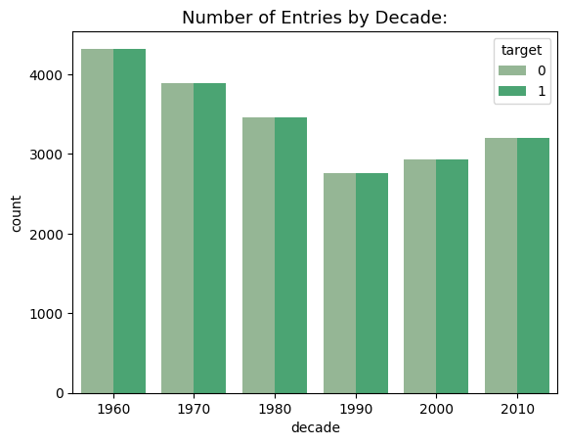
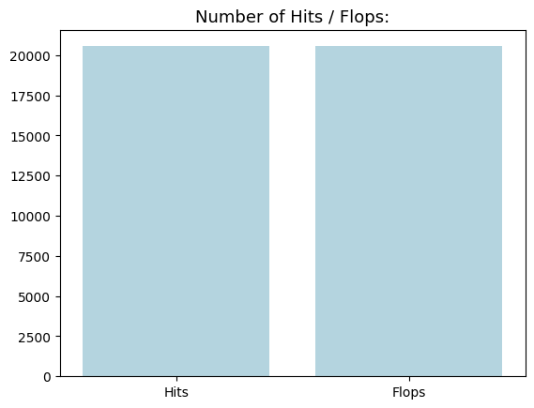
Data Preprocessing
Need to make sure number of 'hits' and 'flops are proportional
Looking at the dataset, they are already perfectly proportional
Bop or Flop? | Justin Lee & Sammy Potter

Slide 14
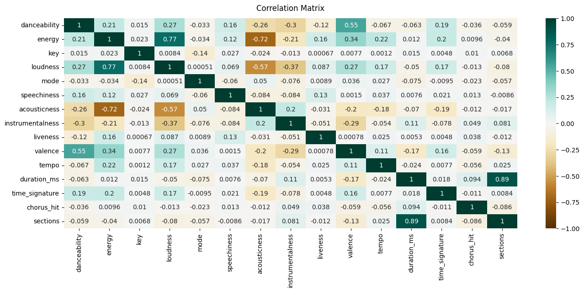
Bop or Flop? | Justin Lee & Sammy Potter

Slide 15
Step 2:
Training Classification Models
Model Preparation
Training:
Decision Tree
Gradient Boosting
Bop or Flop? | Justin Lee & Sammy Potter

Slide 16
Splitting Data
Partitioned the dataset into different sets for training and testing
80% used for training set
20% used for testing set
Bop or Flop? | Justin Lee & Sammy Potter

Slide 17
Training
Decision Tree Classifier trained using sklearn
Gradient Boosting Model trained using sklearn
Bop or Flop? | Justin Lee & Sammy Potter

Slide 18
Decision Tree
Decision Trees recursively classify data based on individual attributes based on branch purity.
Pros
Efficient
Widely used in practical applications
Can be combined into more powerful models
Cons
Prone to overfitting if tree gets too deep
Bop or Flop? | Justin Lee & Sammy Potter

Slide 19
Gradient Boosted Tree
Gradient Boosting uses an ensemble of Decision Trees, and combines them using a loss function.
Pros
High model capacity
Can model complex relationships
Cons
High capacity can lead to overfitting
Bop or Flop? | Justin Lee & Sammy Potter

Slide 20
Step 3:
Analyzing Results
Model Performance Analysis
Confusion Matrices of the Models
Obstacles and Encountered Problems
Bop or Flop? | Justin Lee & Sammy Potter

Slide 21
Model Performance
Decision Tree analysis:
-----------------------------------------
Classification accuracy 0.72148
Classification error 0.27852
Precision 0.71474
Recall / Sensitivity 0.72530
True Positive Rate 0.72530
False Positive Rate 0.28225
Specificity 0.71775
Gradient Boosting analysis:
-----------------------------------------
Classification accuracy 0.79141
Classification error 0.20859
Precision 0.71231
Recall / Sensitivity 0.84700
True Positive Rate 0.84700
False Positive Rate 0.24905
Specificity 0.75095
Bop or Flop? | Justin Lee & Sammy Potter

Slide 22
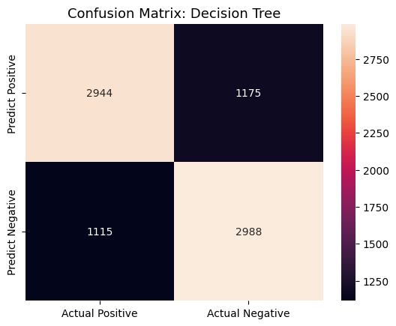
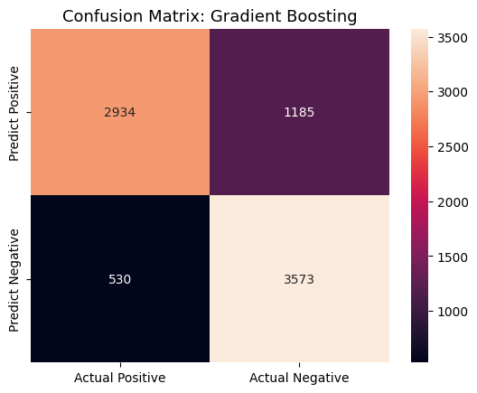
Confusion Matrices
Bop or Flop? | Justin Lee & Sammy Potter

Slide 23
Feature Importance
Decision Tree Feature Importance:
-----------------------------------------
instrumentalness 0.228866
acousticness 0.103122
danceability 0.091549
speechiness 0.076447
duration_ms 0.073270
energy 0.070725
loudness 0.054187
valence 0.052145
tempo 0.049916
liveness 0.048602
chorus_hit 0.046746
decade 0.044127
key 0.022992
sections 0.021951
mode 0.010178
time_signature 0.005175
Gradient Boosting Feature Importance:
-----------------------------------------
instrumentalness 0.446068
acousticness 0.134828
danceability 0.117856
speechiness 0.066420
duration_ms 0.061402
decade 0.060054
energy 0.038931
loudness 0.025344
valence 0.020281
mode 0.010614
sections 0.007140
tempo 0.006818
liveness 0.001457
time_signature 0.001239
chorus_hit 0.000981
key 0.000569
Bop or Flop? | Justin Lee & Sammy Potter

Slide 24
Results & Next Steps
Improve performance of our model
More data?
Removing unimportant attributes?
Testing on tracks outside the dataset
Bop or Flop? | Justin Lee & Sammy Potter

Slide 25
Demo
Bop or Flop? | Justin Lee & Sammy Potter

Slide 26
Thank you!
Bop or Flop? | Justin Lee & Sammy Potter

Slide 27
References
Ansari, F. (2020, April 25). The Spotify hit Predictor Dataset (1960-2019). Kaggle. Retrieved April 20, 2023, from https://www.kaggle.com/datasets/theoverman/the-spotify-hit-predictor-dataset
Spotify: Music for everyone. Spotify. (n.d.). Retrieved April 20, 2023, from https://spotify.com/
Econoscent. (2020, October 10). Visual guide to gradient boosted trees (xgboost). YouTube. Retrieved April 20, 2023, from https://www.youtube.com/watch?v=TyvYZ26alZs&amp;ab_channel=Econoscent
YouTube. (2020, July 16). Visual guide to decision trees. YouTube. Retrieved April 20, 2023, from https://www.youtube.com/watch?v=zs6yHVtxyv8&amp;ab_channel=Econoscent
YouTube. (2020, July 16). Visual guide to decision trees. YouTube. Retrieved April 20, 2023, from https://www.youtube.com/watch?v=zs6yHVtxyv8&amp;ab_channel=Econoscent
Bop or Flop? | Justin Lee & Sammy Potter

